Slide 1
Automatic Metadata Discovery from Non-cooperative Digital Libraries
By
Ron Shi, Kurt Maly, Mohammad Zubair
IADIS International Conference
May 2003

Slide 2
Table of content
Introduction
Motivation
Problem
Solution
Approach
Challenges
Automated Metadata Discovery and Retrieval
Future Works
Conclusion
Questions
References

Slide 3
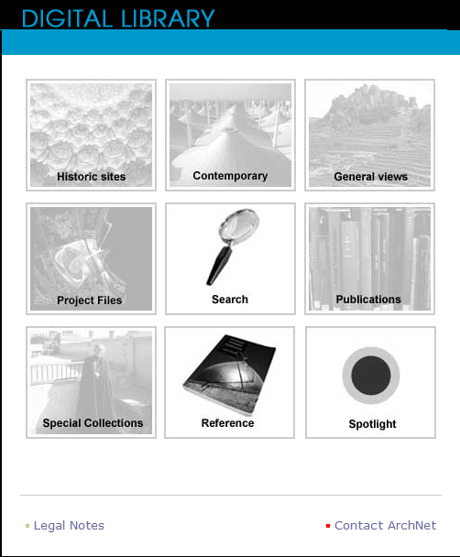
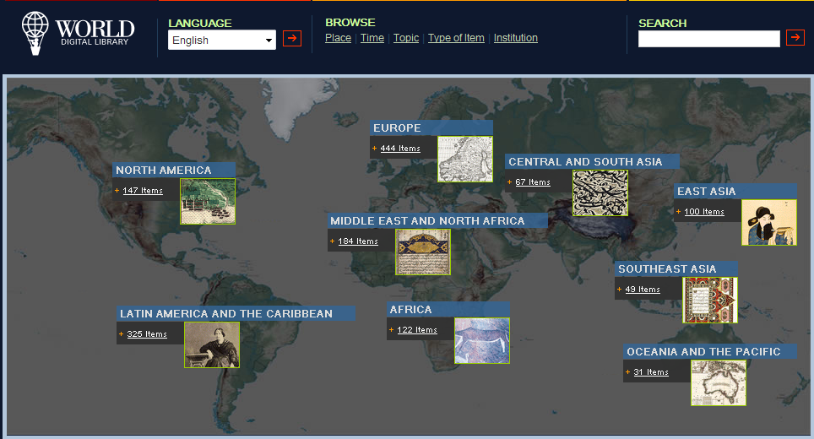




Introduction
What is a digital library?

Slide 4

Motivation
Growing number of digital libraries on the Internet
Each implementation done independently from the others
Provide interoperable service across heterogeneous systems

Slide 5
Problems
Independent data providers without following any common protocol
Digital library does not provide metadata or a way to obtain its metadata
  Each digital library has its own way to define metadata
  Each digital library can display any subset of its metadata at its own discretion
  Each digital library has its own rules as to which metadata to display and in what form

Slide 6
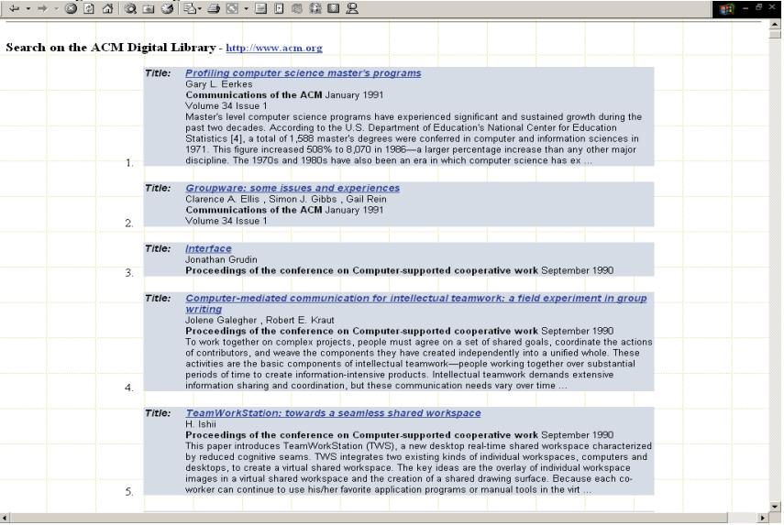
Sample Search results of ACM DL

Slide 7
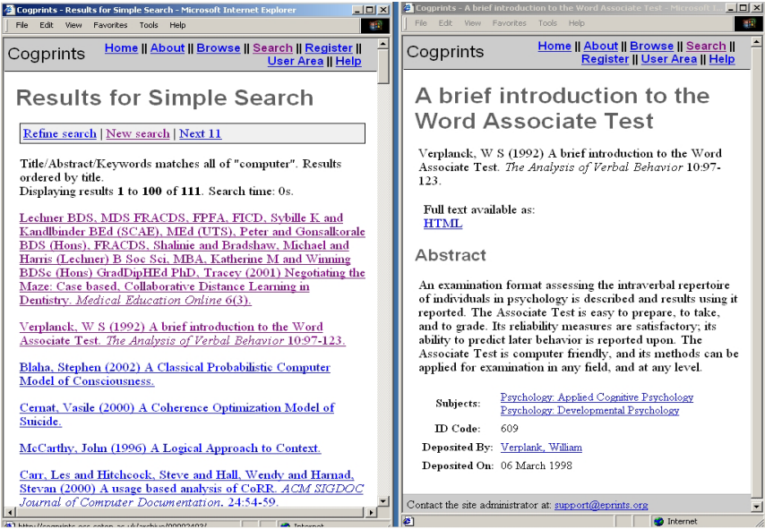
Sample result list page and record page of Cogprint DL

Slide 8
Proposed Solutions
Lightweight Federated Digital Library
Provide a metadata retrieval mechanism for non-cooperating digital libraries
Post processing techniques based on general web search-engines

Slide 9
Approaches
Metadata Harvesting
  Collect data at a central location from different digital libraries
  Unified search interface
Distributed Search
  Metadata resides at its original location
  Only retrieve relevant metadata when needed

Slide 10
Challenges
Flexible integration
Transparent relocation and/or deletion of digital libraries
Performance requires post processing of data

Slide 11
Automatic Metadata Discovery and Retrieval

Slide 12
Approach
Generic universal search interface based on Dublin Core
Dublin Core is a set of metadata descriptions about resources on the Internet
Simple Dublin Core Metadata Element Set (DCMES) consists of 15 metadata elements
Develop a search engine that retrieves pages with metadata
Define rules to extract metadata from these pages
Develop a metadata parser
Use Dublin Core metadata set as a common set
All individual DL’s metadata fields are mapped to the closest Dublin Core field

Slide 13
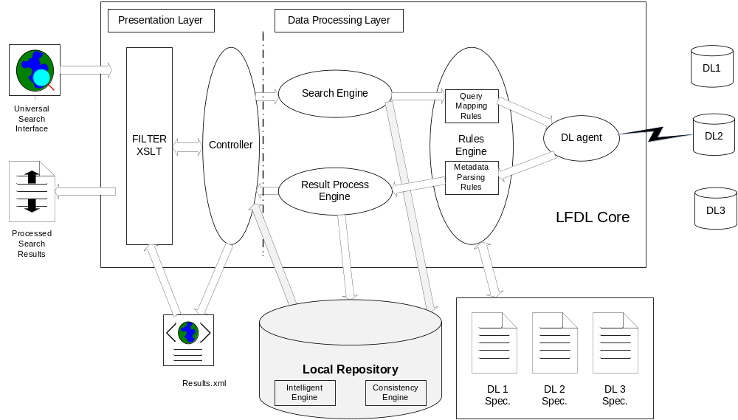
Architecture

Slide 14


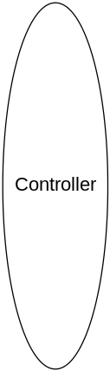

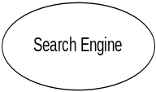
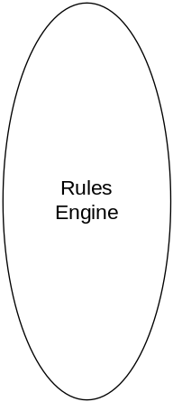














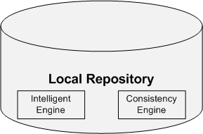
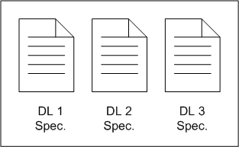

Architecture (cont.)

Slide 15
Retrieval and Parsing
Results Process Engine checks for parsing rules from the DL specifications
Process Engine applies parsing and generate metadata to be stored in a cache
If DL specification also defines lower level metadata parsing rules, all record HTML pages will be retrieved from remote DL, and parsed
Extra process on cached metadata so that they are ready to be displayed
Results are merged and then displayed to end-users
Periodically, cached metadata will be saved to persistent storage such as a database

Slide 16
Metadata Parsing Rules Definition
Same DL XML specification for metadata parsing rules as for query mapping and metadata retrieval
Digital Library Definition Language is extended to:
  Result list page level
  Single record document level
Raw string is separated into several segments, each segment has one or several metadata fields

Slide 17
Local Repository – Intelligence Cache
Parsed metadata is stored in local database
Improved search performance
Improved service reliability
Cache grouped by metadata group provides service quality as good as the search service provided by individual DL
Consistent engine maintains consistency between local storage and remote digital libraries

Slide 18
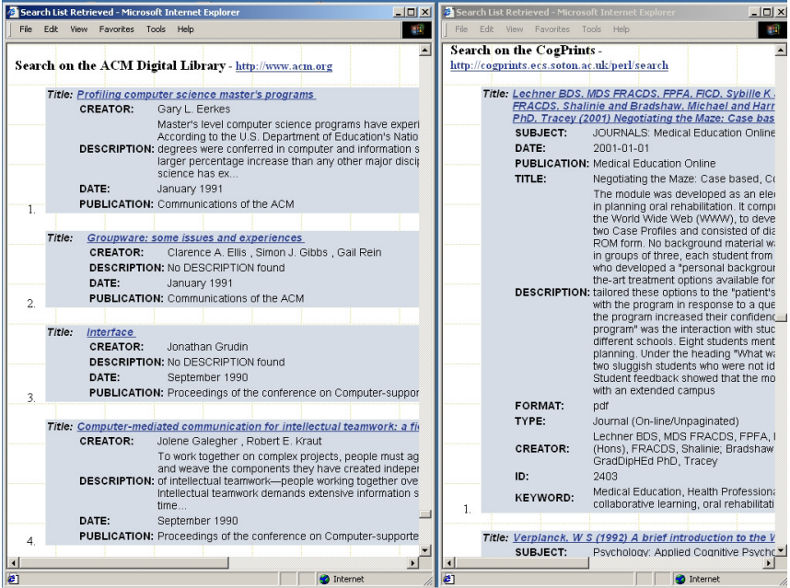
Post processed results in LFDL after metadata parsing

Slide 19
Future Works
Improve performance through intelligent caching
Improve service quality through better navigation tool sets

Slide 20
Conclusions
Pros
  Easy to follow
  Comprehensive background information of the problem
  Detail explanation on design architecture
Cons
  Incomplete on caching and service
  How to dedupe similar information
  Repetitive information throughout the paper

Slide 21
Conclusions (cont.)
Improvements
  Combine crawling with LFDL
  Clearly defined scope
  Utilize open source architecture like Hadoop and/or Solr
  Use internet cloud for better availability
  Demonstrated financial incentives of this subject

Slide 22
Questions

Slide 23
Reference
R. Shi, K Maly, M. Zubair, “ Automatic Metadat Discovery from Non-cooperative Digital libraries” , IADIS International Conference e-Society, Lisbon, Portugal, Nov 2003
Fotosearch, http://www.fotosearch.com/bigcomp.asp?path=UNN/UNN501/u14104684.jpg
Wikipedia, http://en.wikipedia.org/wiki/Dublin_Core
Answers, http://www.answers.com/topic/dublin-core
R Shi, “Lightweight Federation of Non-Cooperative Digital Libraries”, Ph D Dissertation, Old Dominion University, 2005
W. Arms, Digital libraries. Cambridge, MA: MIT Press, 1999
S. M. Griffin, “ Taking the initiative for Digital Libraries,” The Electronic Library, vol. 16, no. 1, pp. 24-27, Feb. 1998
A. Paepcke, C. K. Chang, T. Winograd, and H. Garcia-Molina, “ Interoperability for digital libraries worldwide,” Communications of the ACM, vol. 41, no. 4, pp. 33-43, April 1998

